Slide 1

QUALITY SYSTEMS A STRATEGY
M.Pandurangan MBCS

Slide 2


A research report from Deutsche Bank, "IT in banks: what does it cost? High IT costs call for an eye on efficiency" states that banks' IT costs are much higher compared to those in other industries. IT staff costs especially, were on average about 31% of the total IT budget.
WHY ?
Do the Information Systems have Quality
like this ?
Do you know that undue complexity and lack of sufficient quality in Information Systems are a major contributor to increasing IT costs in organizations today ?

Slide 3

“Concepts” - Does your IT Team have an understanding of what this is?
A clear and complete understanding of “concepts” is fundamental to a “good” business application system; while we tend to take this for granted since this is obvious, we will be surprised when we come to learn that different systems do not have a common understanding of what each business entity means from the business/customer context and which needs to be aligned to all the fields/columns defined across all the systems e.g. “Create Customer” in one system is meant to be exactly that (i.e. create a new “Customer” record) while in another system, the same phrase “Create Customer” is taken to mean “open a new account”.
"The beginning of wisdom is to call things by their right names" – Confucius
“Almost all grave software problems can be traced to conceptual mistakes made before programming started.” - Daniel jackson, Dependable Software by Design, Scientific American, June 2006

Slide 4
Is there also undue Complexity in the current system ?
“In the long run, the reduction of complexity makes it possible to do far more than control the purchase of new servers and software: it also helps companies to deflate their ballooning IT maintenance and development costs in a more general way …….”
-Frank Mattern, Stephan Schonwalder and Wolffram Stein, “Fighting Complexity in IT”, the Mckinsey Quarterly, 2003 number 1.

Slide 5

Or are there deficiencies in the current processes ………
“….deficiencies in the structure of IT processes contributed to the complexity that now bedevils many organizations.”
- Frank Mattern, Stephan Schonwalder and Wolffram Stein, “Fighting complexity in IT”, The McKinsey Quarterly, 2003 Number 1.

Slide 6
Are there Silos in your IT Teams ?............
“It is axiomatic that the whole is equal to the sum of its parts. But in dividing up any ‘whole’, one must be certain that every part, including unseen elements and relationships, is accounted for.
It is self-evident that the more the work is sub-divided, the greater is the danger of confusion, and the greater is the need for overall supervision and co-ordination. Co- ordination is not something that develops by accident. It must be won by intelligent, vigorous, persistent, and organized effort.
In a large complicated enterprise, the organization becomes involved, the lines of authority tangled, and there is danger that the workers will forget that there is any central purpose, and so devote their best energies only to their own individual advancement and advantage.”
- Gulick, L.

Slide 7
Are Communications between the IT Teams and the Business Stakeholders, as well as within the IT teams effective ? How do you verify that communication has happened ?
The single biggest problem in communication is the illusion that it has taken place.
------ George Bernard Shaw

Slide 8
Communication - Misinterpretation of a fact
Captain L had a first mate who was at times addicted to the use of strong drink, and occasionally, as the slang has it, “got full”. The ship was lying in port in China, and the mate had been on shore and had there indulged rather freely in some of the vile compounds common in Chinese ports. He came on board, “drunk as a lord”, and thought he had a mortgage on the whole world. The captain, who rarely ever touched liquor himself, was greatly disturbed by the disgraceful conduct of his officer, particularly as the crew had all observed his condition. One of the duties of the first officer (the first mate) is to write up the log each day, but as that worthy was not able to do it, the captain made the proper entry, but added: “The mate was drunk all day”. The ship left port the next day and the mate got “sobered off”. He attended to his writing at the proper time, but was appalled when he saw what the captain had done. He went back on deck, and soon after the following colloquy took place:
“Cap’n, why did you write in the log yesterday that I was drunk all day ?” “It was true, wasn’t it ?”
“Yes, but what will the shipowners say if they see it ? It will hurt me with
them.”
But the mate could get nothing more from the Captain than, “It was true, wasn’t it ?”
The next day, when the Captain was examining the book, he found at the bottom of the mate’s entry of observation, course, winds and tides:
“ The captain was sober all day.”
(Trow, 1905, pp. 14-15)

Slide 9
Communication – Various Interpretations
How many ways are there to interpret the sentence below:
“Do I have to do it ?”
Do “I” have to do it:
▪ can this be delegated ?
▪ am I the best person to do this ?
Do I have to “do” it – is the task really necessary ?
Do I have to do “it” – is this the correct task to be done ?

Slide 10
Are there issues of SEMANTICS ?
“‘When I use a word,’ Humpty Dumpty said, in rather a scornful tone,
‘it means just what I choose to it to mean – neither more nor less.’ "
- Lewis Carroll, “Alice’s Adventures in Wonderland”
Poor quality design can have field (Database Column) names totally irrelevant to the data contained within.

Slide 11
Is there Micromanagement ? – 1 of 2
Management Subject – Object Asymmetric
The means-end-relation is immanent and possible to set out explicitly
Basic metaphors: strategy, domination, control, guidance, instructions, requests, orders, commands, or threats, obeyance, adaptation, acceptance of authority, inequality
Few possibilities to question legitimacy
A closed, “formatted” space
A projected, anticipated time (authoritative logistics)
A strong organizational centre
Science

Slide 12
Is there Micromanagement ? – 2 of 2
Leadership Subject – Subject Symmetric
The means-end-relation is transcendent and not possible to set out explicitly
Basic metaphors: dialogue, teaching, request, appeal, commitment, empathy, identify oneself with, understanding, reciprocity, solidarity
Absolute demands to legitimacy
A free space • An open, poetic, an adventurous time (organic logistics)
No formal, organizational centre
Magic
Kirkeby, Ole Fogh(2000), “Management Philosophy A Radical-Normative Perspective”,
Reprinted with permission from Springer-Verlag Berlin-Heidelberg.

Slide 13
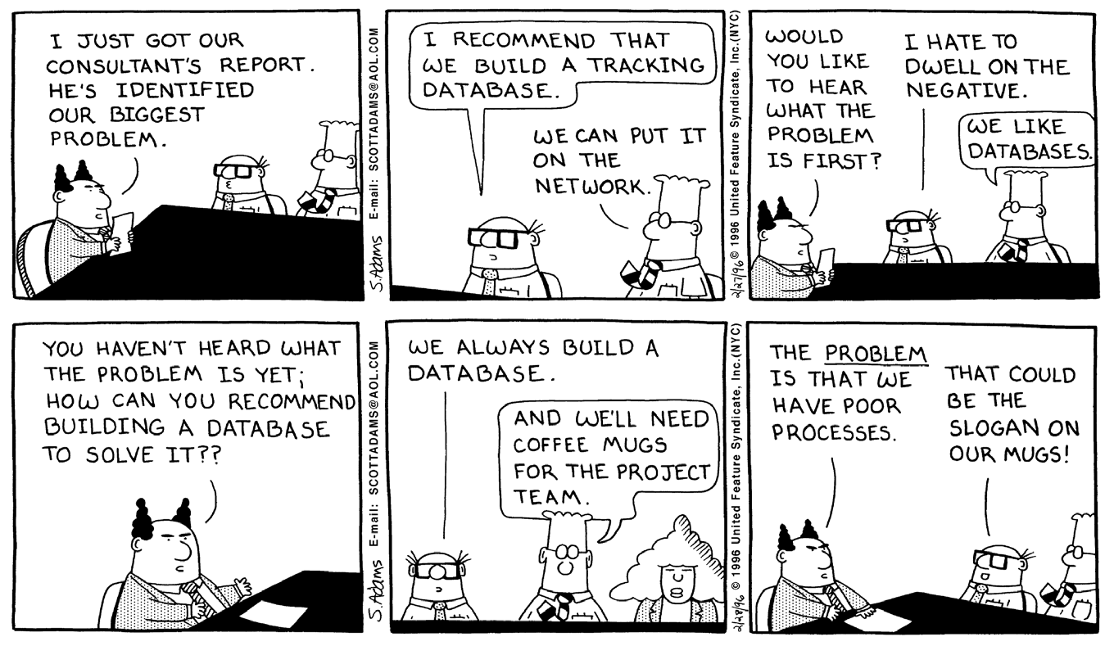
Is the real problem understood before a solution is proposed ?
Reprinted with permission from UNITED FEATURE SYNDICATE, INC

Slide 14
Are there “Disconnects” in the System/Process ?
Examples:
Within the system - an inconsistency in an internet application system between new account registration where Surname is not mandatory while retrieval of the account requires a valid Surname (i.e. not spaces) to be entered. Impact to customer – unable to retrieve the account and resort to call centre’s help.
Within and outside the system - a carpark offence system which is computerized, while the process to appeal for waiver of the penalty is a manual process; there was no interface between the two systems and thus a situation arose where while the appeal was still being considered, the computerized system duly sent reminders to the offender to make payment.
A tragic real life example is mentioned in the book “Infosense Turning Information into Knowledge” by Keith Devlin – see “The Story of Flight AA965” in Chapter 7 (“The View from Above”).
Devlin, Keith(2001),” Infosense Turning Information into Knowledge”,(41 Madison Avenue, New York, NY 10010 : W.H.Freeman and Company)

Slide 15
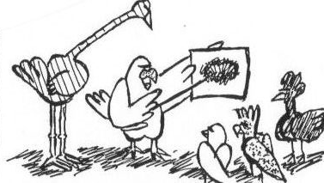
Does “Effective Listening” happen in your organization – how can you verify ?
And then Madge Magpie cried: Alas! How can I teach silly birds to build nests if they will not listen to what I say?”

Slide 16
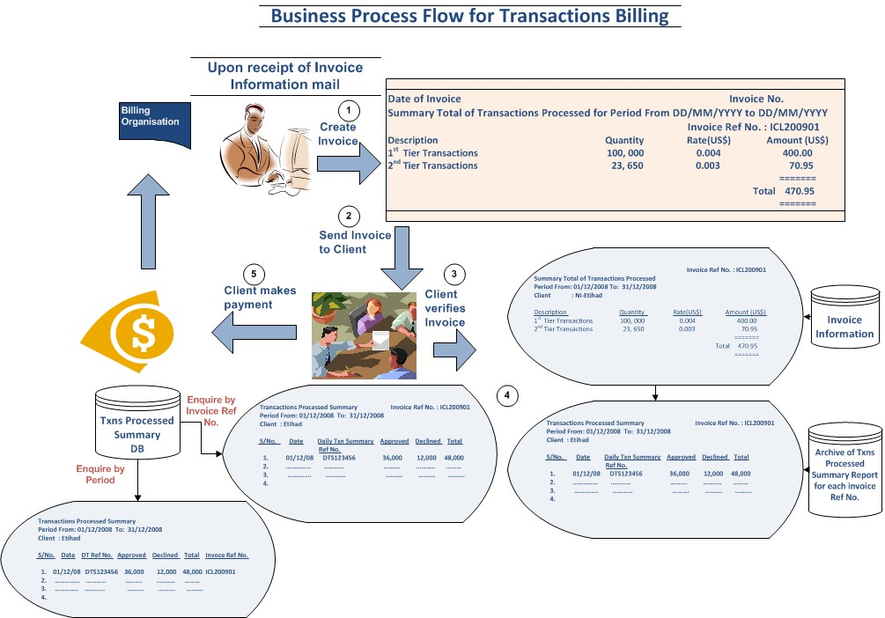
Is a single document available that contains both the Business Process Flow and the corresponding System Process Flow ?

Slide 17
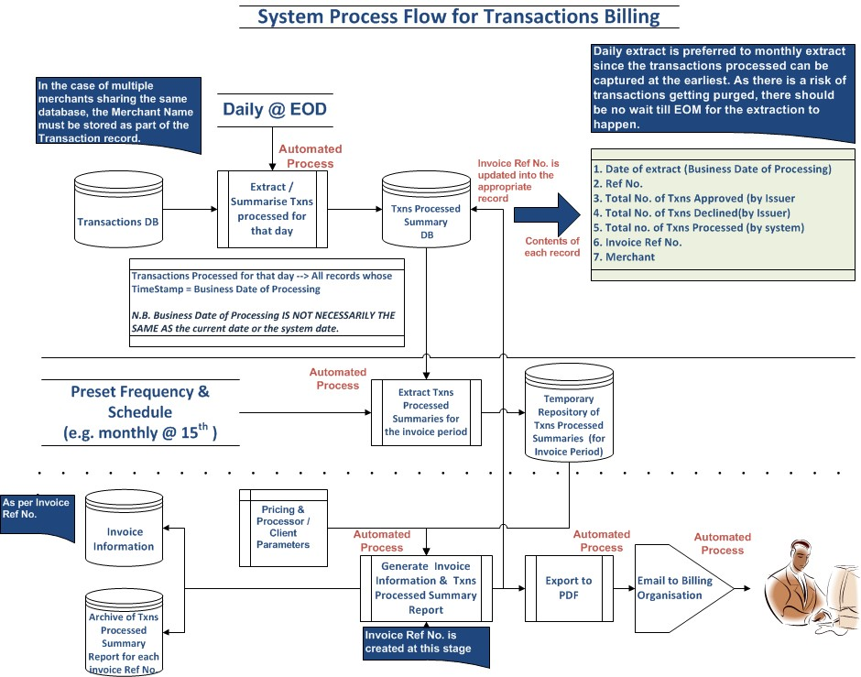
Is a single document available that contains both the Business Process Flow and the corresponding System Process Flow ?

Slide 18
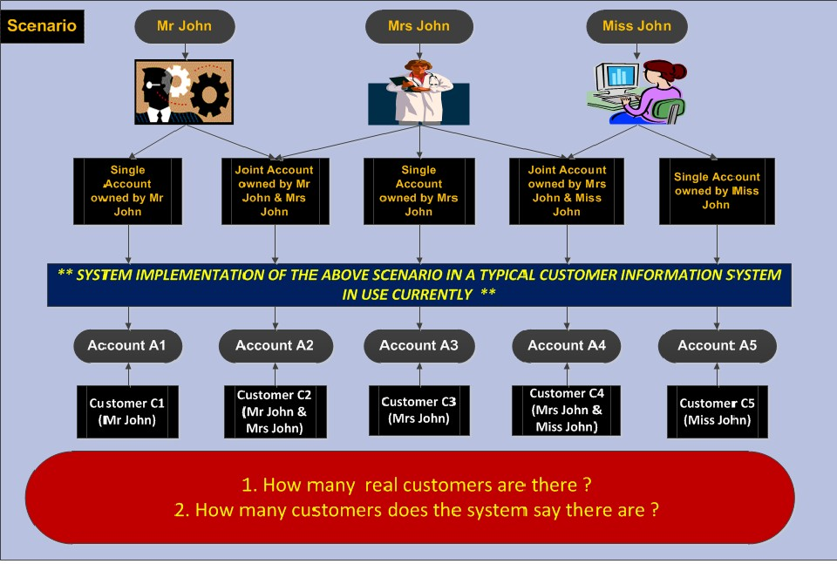
Does the System model the real world ?

Slide 19
Thank You

